Slide 1


Project on
Online Course Pricing and Quality Analysis
(Website : Class Central)
Presented by :
Name : Gounda Sohail Basha
Batch No : 436
Branch : Dilsukhnagar

Slide 2

About me
I am Gounda Sohail Basha.
I completed my B.Tech in Mechanical Engineering from G Pulla Reddy Engineering College.
Linkedin : www.linkedin.com/in/sohailbasha789
Github : https://github.com/Sohail-Basha

Slide 3

Agenda
Introduction & Problem Statement
Business Problem & Objectives
Data Collection & Preparation
Data Understanding & Cleaning
Exploratory Data Analysis
Univariate Analysis
Bivariate Analysis
Multivariate Analysis
Hypothesis Testing
Key Insights & Recommendations
Conclusion
Q&A

Slide 4

Introduction
Online education has grown rapidly, and today there are thousands of courses available across different platforms. These courses come with different pricing models in which some are free, while others are paid. However, it is not always clear whether paid courses are actually better in quality than free ones.
Many learners rely on ratings and reviews to judge a course, but these numbers can sometimes be misleading if they are not analyzed properly. Different platforms also present information in different ways, making it difficult to compare courses fairly.
This project uses web scraping and data analysis to study the relationship between course pricing, ratings, and reviews. The goal is to understand whether paid courses truly perform better than free courses and to provide clear, data-driven insights that can help learners make better decisions.

Slide 5

Problem Statement
Online learning platforms offer many courses with different pricing options, such as free and paid. However, it is not clear whether paid courses are actually better in quality than free ones.
Learners usually depend on ratings and reviews to choose a course. But without proper analysis, these numbers can be misleading. Different platforms also show course information in different ways, which makes comparison difficult.
Because of this, learners often make decisions based on assumptions instead of data.
The Agenda through this project is to solve this problem by collecting and analyzing course data to understand the relationship between pricing, ratings, and reviews in a clear and data-driven way.

Slide 6
Business Problem Statement
Educational platforms, training institutes, and learners rely on course ratings and pricing information to evaluate course quality and value. However, insights based on a single platform may provide only a partial and sometimes misleading view.
Different platforms use different pricing labels and present ratings and reviews in various formats. This makes it difficult to clearly understand whether paid courses truly offer better quality than free courses. Without a consolidated and data-driven analysis, learners may choose courses based on assumptions rather than reliable insights.
The main goal is to address the business problem by collecting course data through web scraping and analyzing pricing, ratings, and engagement patterns to provide clear, actionable insights into online course quality.

Slide 7

Objective
Analyze online course data collected through web scraping to understand overall quality and pricing trends.
Compare free and paid courses to evaluate differences in average ratings.
Study review distribution to understand learner engagement patterns.
Identify whether paid courses significantly outperform free courses in terms of ratings.
Analyze platform-wise rating trends to compare course quality across providers.
Examine the relationship between ratings and reviews to assess reliability of learner feedback.
Provide data-driven insights to help learners make informed course selection decisions.

Slide 8
Data Collection & Merging
Course data was collected from an online learning platform(Class Learn) using web scraping techniques.
Information such as course name, platform, rating, reviews, and pricing type was extracted.
All extracted data was stored in a structured format using a consistent column structure.
Pricing information was standardized into two categories: Free and Paid.
Data cleaning was performed to handle missing values and inconsistent labels.
The final consolidated dataset contained 405 courses ready for analysis.
DataSet : Courses

Slide 9
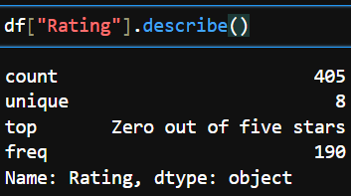
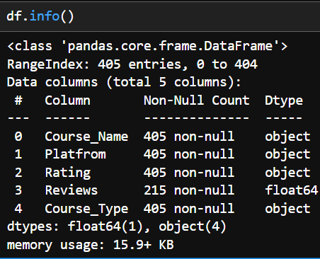
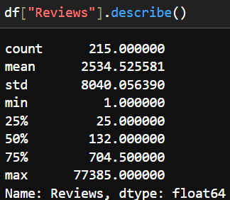
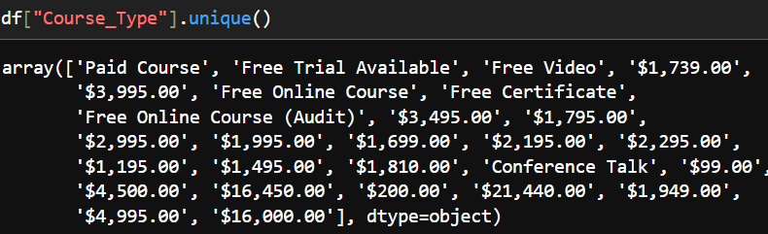
Data Understanding
The dataset contains 405 online courses.
It includes Course Name, Platform, Rating, Reviews, and Course Type.
Ratings and reviews are in numeric format.
Course Type had different labels like “Paid Course”, “Free Trial Available”, and “Conference Talk”.
No missing values were found in the dataset.
Ratings range from 0 to 5.
Review counts vary a lot, with some courses having very high reviews.
The review data is right-skewed, meaning only a few courses have very high engagement.
Some cleaning was needed to make the pricing categories consistent before analysis.

Slide 10

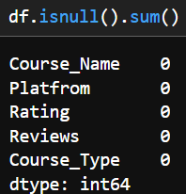
Data Cleaning
The scraped course data had inconsistent pricing labels and mixed formats.
Some course types were labeled differently, such as “Paid Course”, “Free Trial Available”, and “Conference Talk”.
These labels were standardized into two clear categories: Free and Paid.
Ratings were already in numeric format and ranged from 0 to 5.
Review counts were numeric, but showed large variation.
No missing values were found in the dataset.
Column names were corrected for consistency (e.g., spelling fixes).
The final cleaned dataset contained 405 courses ready for analysis.
Cleaning ensured accurate comparison between Free and Paid courses.

Slide 11
Data Features
Course Name – Title of the online course
Platform – Platform offering the course (e.g., Coursera, Udemy)
Rating – Average user rating of the course (0 to 5 scale)
Reviews – Total number of user reviews for the course
Course Type – Pricing category of the course (Free or Paid)

Slide 12
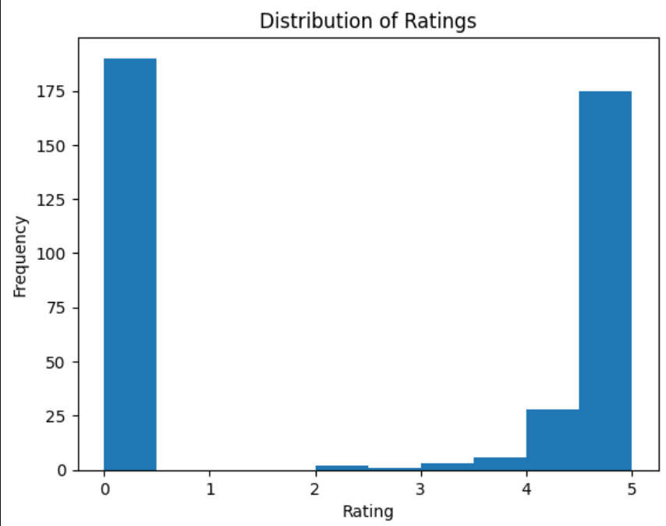
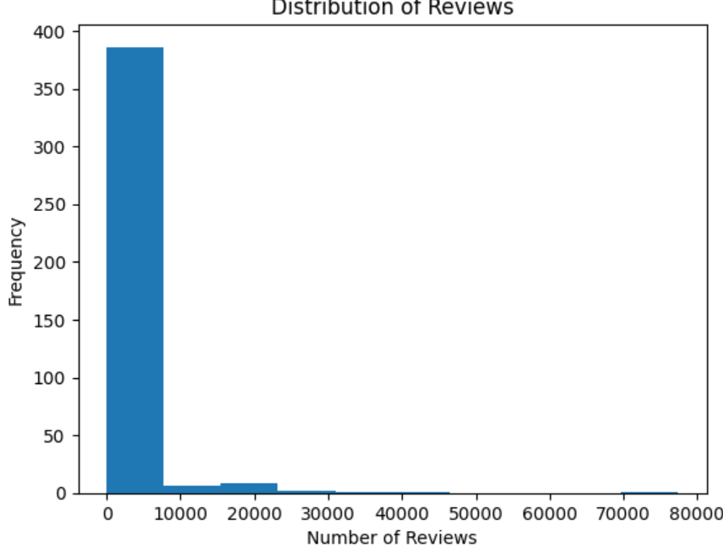
Univariate Analysis
Rating Distribution
Review Distribution
Ratings range from 0 to 5
Most courses are rated between 4 and 5.
Median rating is 4.0
Distribution shows concentration at higher ratings.
Review counts are highly right-skewed
Most courses have very few reviews.
A small number of courses have extremely high engagement
Maximum reviews: 77,385.

Slide 13
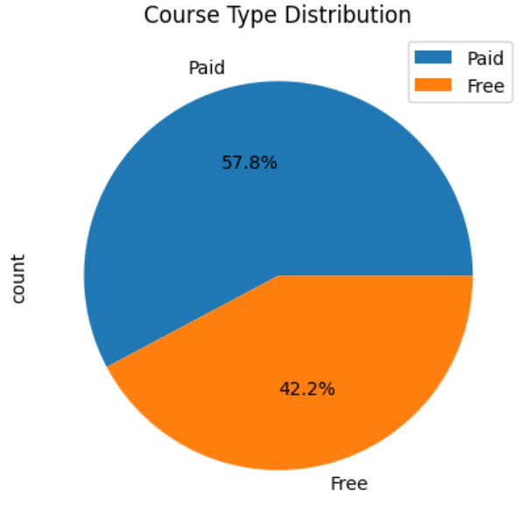
Univariate Analysis
Course Type Distribution
Paid courses: 234
Free courses: 171
Dataset is fairly balanced for comparison.

Slide 14
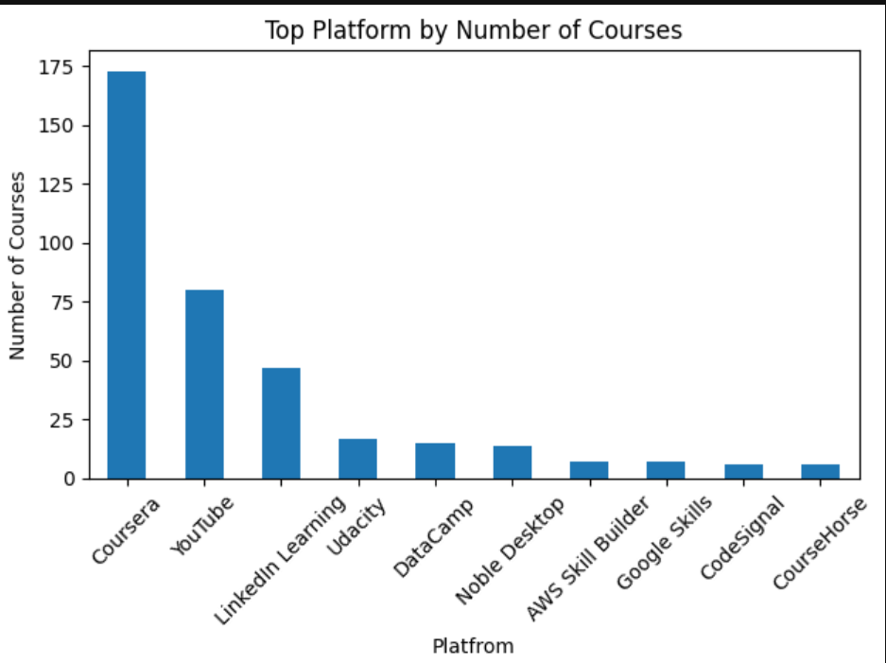
Univariate Analysis
Platform-wise Course Distribution
Some platforms host more courses than others.
Platform distribution helps understand content concentration.
These are Top 10 Platforms

Slide 15
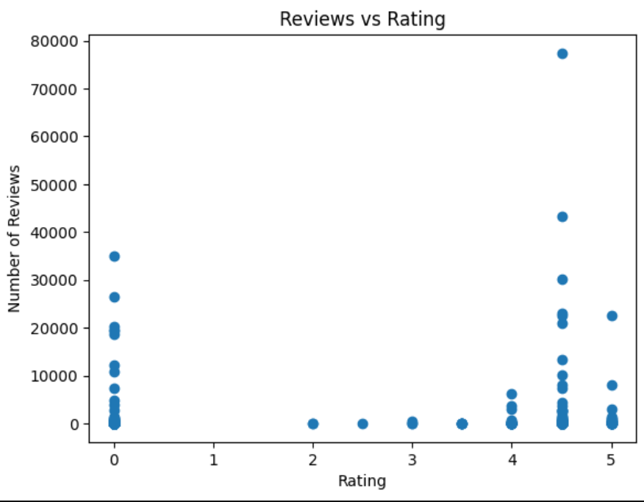
Bivariate Analysis
Relationship Between Course Rating and Reviews
Most courses with high review counts have ratings above 4.0.
Courses with low ratings generally have fewer reviews.
Review distribution is highly skewed, with a few courses having extremely high engagement.
There appears to be a positive relationship between rating and number of reviews.

Slide 16
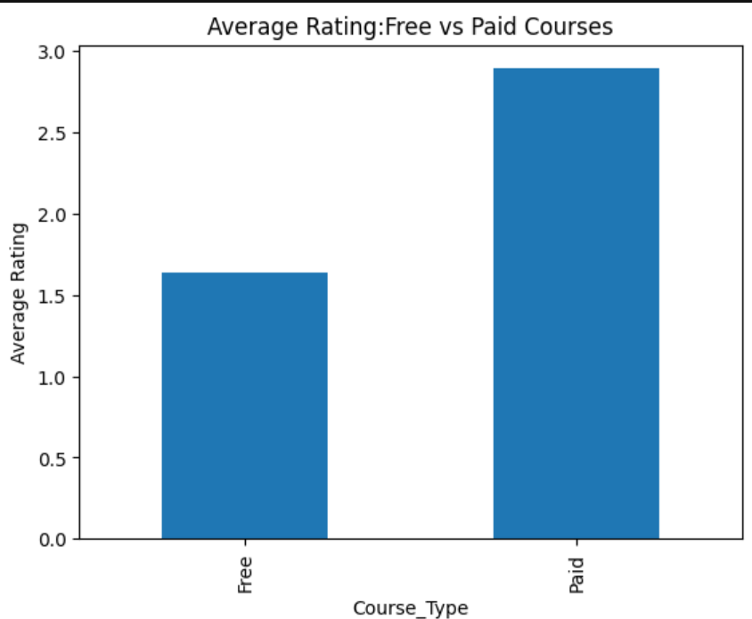
Bivariate Analysis
Average Rating: Free vs Paid Courses
Free → 1.64
Paid → 2.89
Paid courses have a higher average rating compared to free courses.
Free courses show lower average ratings overall.
This suggests learners may perceive paid courses as higher quality.

Slide 17
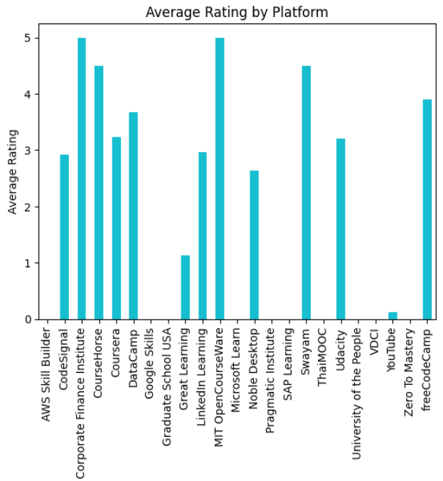
Bivariate Analysis
Bar chart compares average ratings across different learning platforms.
Ratings vary across platforms, indicating differences in course quality or learner perception.
Some platforms show consistently higher average ratings.
Lower average ratings on certain platforms may indicate variability in course quality.
Average Rating by Platform

Slide 18
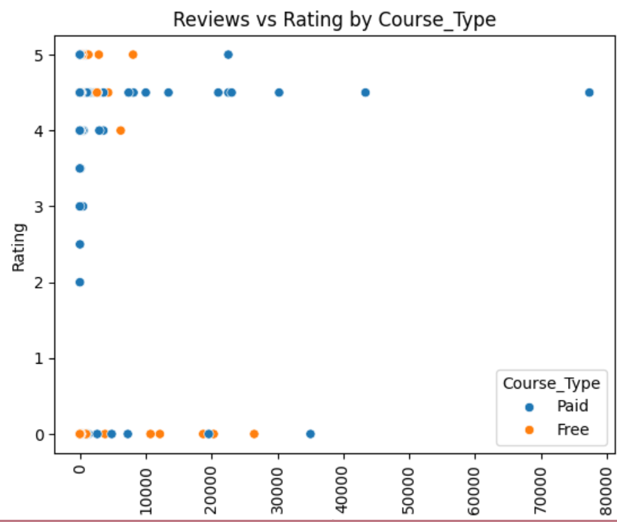
Multivariate Analysis
Reviews vs Rating by Course Type
Scatter plot analyzes relationship between reviews, ratings, and course type.
Paid courses dominate higher review ranges.
High-rated courses generally receive more reviews.
Free courses are concentrated in lower review ranges.
Positive association observed between rating and engagement.
Review distribution is highly skewed, indicating a few highly popular courses

Slide 19
Hypothesis Testing
Hypothesis 1: Do Paid Courses Have Different Ratings than Free Courses?
Hypotheses
H₀ (Null Hypothesis): There is no significant difference in average ratings between Free and Paid courses.
H₁ (Alternative Hypothesis): There is a significant difference in average ratings between Free and Paid courses..
Method Used: Independent Two-Sample t-test
Result: t-statistic = 5.73
p-value = 2.10e-08
Significance level (α) = 0.05
Conclusion: Reject H₀
There is a statistically significant difference in ratings.

Slide 20
Hypothesis Testing
Hypothesis 2: Do Paid Courses Receive More Reviews?
Hypotheses
H₀ (Null Hypothesis):
There is no significant difference in review counts.
H₁ (Alternative Hypothesis):
There is a significant difference in review counts.
Method Used: Independent Two-Sample t-test
Result: t-statistic = 5.73
p-value = 2.10e-08
Significance level (α) = 0.05
Conclusion: Reject H₀
There is a statistically significant difference in ratings.

Slide 21
Key Insights & Recommendations
Key Insights:
Paid courses have significantly higher average ratings compared to free courses.
No statistically significant difference exists in review counts between free and paid courses.
Review distribution is highly skewed — a few courses receive extremely high engagement.
Higher ratings are moderately associated with higher review counts.
Some platforms consistently show higher average ratings than others
Recommendations:
For Learners
Paid courses may offer better perceived quality based on ratings.
Review count should be considered along with rating for better course selection.
For Course Providers
Pricing strategy influences perceived course quality.
Improving content quality may increase both ratings and engagement.
Encouraging reviews can improve visibility and credibility.

Slide 22
Conclusion
There is a statistically significant difference in ratings between Free and Paid courses.
Paid courses tend to receive higher average ratings.
No significant difference was found in review counts between course types.
Course engagement is unevenly distributed, with few courses dominating reviews.
Pricing appears to influence perceived quality, but not necessarily engagement.
Notes:
textbox
No alt text provided
textbox
No alt text provided
textbox
No alt text provided
textbox
No alt text provided
textbox
No alt text provided
textbox
No alt text provided
textbox
No alt text provided
textbox
No alt text provided
actionButton
No alt text provided

Slide 23
?
Any
Questions

Slide 24

Thank you

